Slide 1


Edge Control
Serving traffic effectively to people
CAPIF | Bishkek, Kyrgyzstan & Virtual | 25th September 2024
Ben Ryall
Edge Strategy Manager
bjr@meta.com

Slide 2

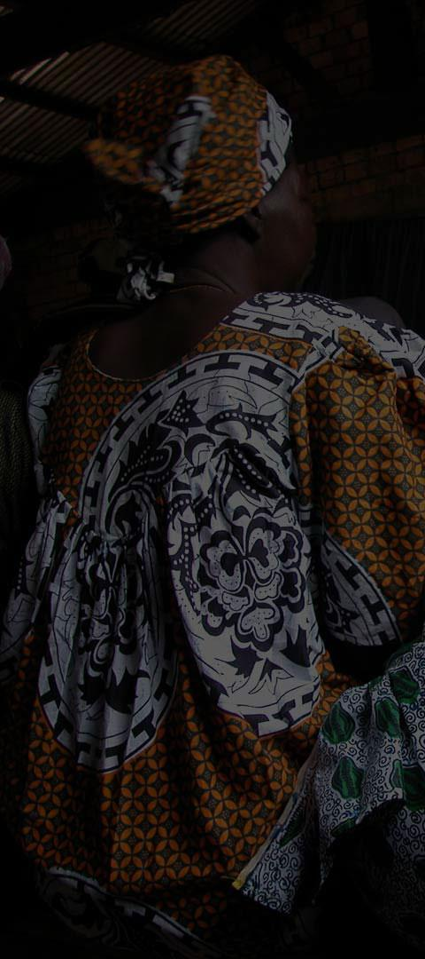






Notes:
Multiple types of product
Messenger, Instagram, Facebook, WhatsApp

Slide 3
20
80+
7,000+
3.27B
Origin Datacenter Regions
Edge PoP Markets
In-network Appliances
Family MAP, as of July 31st 2024
Notes:
20 Origin DC regions – housing millions of servers, interconnected by one of the largest software defined backbones
80 edge pop markets, with 100s of pops across the globe. Interconnected by our Edge Backbone.
Well over 7000 caching clusters, deep inside ISP networks helping us deliver the most popular picture and video content
Over 3.88B users using our family of apps

Slide 4

Why is my traceroute going over the Internet?
Why isn’t all my traffic being served over the peering/caching we just setup?
Notes:
There are two common questions we are looking to answer through this presentation…
<CLICK> Why is my traceroute to www.facebook.com going over the Internet
<CLICK> Why isn’t all my traffic being served over the peering and/or caching we just setup

Slide 5

1
Serving from the Edge

Slide 6
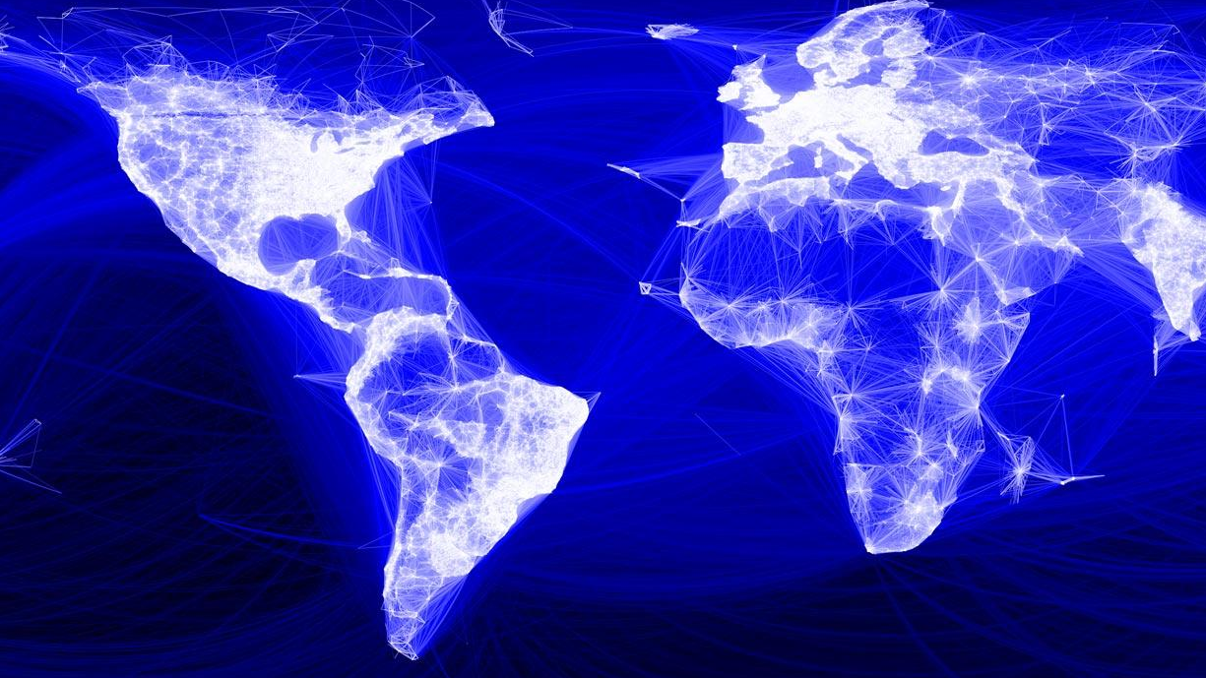





Locations are for visualisation purposes, it does not reflect current configuration.
Notes:
<CLICK> The slide will run showing traffic being served from Africa
<CLICK> Africa PoPs disappear and shows traffic being served from Europe
Our systems are designed to serve traffic from the nearest PoP to users…in the case of failure we will continue to serve traffic, but from the next nearest PoP
In the case of Arica, in the event of failure, traffic will generally be served from Europe
Graph shows what happens when traffic fails out of a country. In this example you can see latency on the light green line goes from under 50ms to 200ms, showing what the impact can be, when things ail

Slide 7
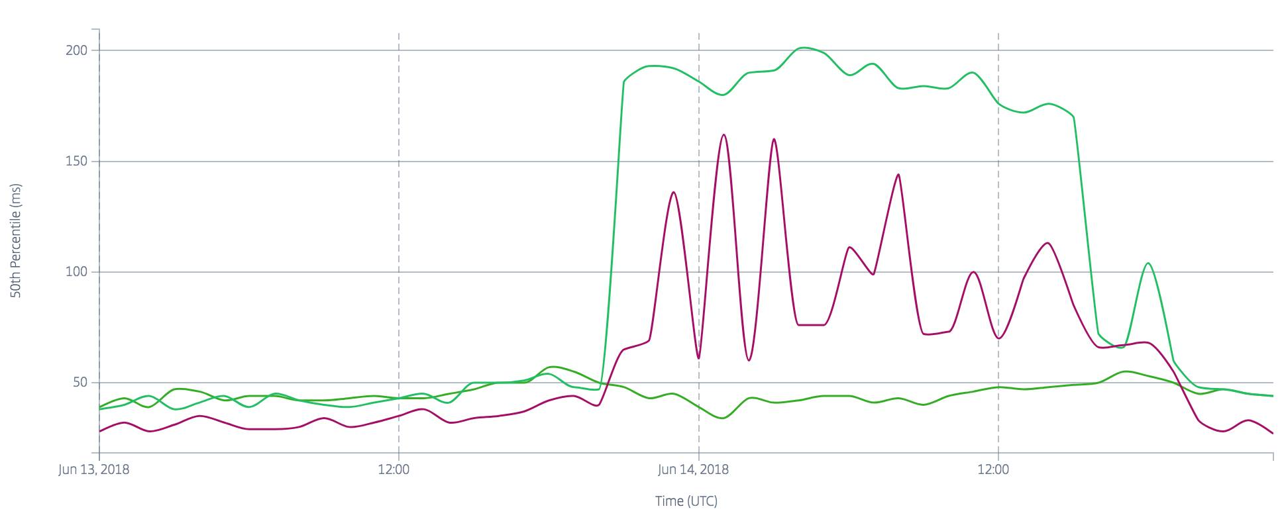
Notes:
<CLICK> The slide will run showing traffic being served from Africa
<CLICK> Africa PoPs disappear and shows traffic being served from Europe
Our systems are designed to serve traffic from the nearest PoP to users…in the case of failure we will continue to serve traffic, but from the next nearest PoP
In the case of Arica, in the event of failure, traffic will generally be served from Europe
Graph shows what happens when traffic fails out of a country. In this example you can see latency on the light green line goes from under 50ms to 200ms, showing what the impact can be, when things ail

Slide 8

Static
images
videos
css
jss
Dynamic
News Feed
likes
status Updates
Notes:
Our products are different from many OTT services
<CLICK> two main parts, the typical static content, but also dynamic content
<CLICK> dynamic content is… this changes dynamically and needs global consistency

Slide 9

TRAFFIC STEERING
Notes:
- AS Path prepared, med
- Keep prefixes consistent
- Talk to us if you desire different actions to happen

Slide 10

2
Traffic Control
Notes:
So we’ve talked about how we serve traffic, lets talk about how we control….

Slide 11

Measuring Closeness
We care about Performance
Sonar is our one of our tools
CLOSENESS
Thumbnail requests sent from multiple PoPs
Allows us to measure latency
Notes:
How to we quantify? sonar
Sonar spreads a small percentage of thumbnail requests for a given DNS Resolver around the network, so we can measure performance.

Slide 12


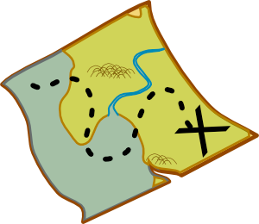

Global controller architecture
Internet
ISP A DNS resolver
ISP B DNS resolver
ISP C DNS resolver
ISP D DNS resolver
A 1.2.3.4
A 1.2.3.5
A 1.2.3.4
A 1.2.3.6
Facebook Infrastructure
capacity
global
controller
DNS map
DNS Server
resolvers/latency
routing
health
offline processing
Notes:
Taking the latency inputs from Sonar and other systems, we have a global controller that uses DNS to manage which POP will handle the users request
<CLICK> Fracebook Global controller graphic loads
<CLICK> DNS Map / DNS Server graphic loads
<CLICK> Internet cloud and DNS resolvers laods, showing different IP addresses

Slide 13

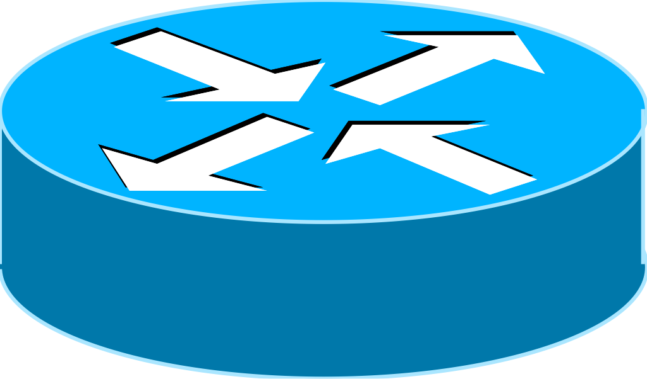

Metro-level BGP peering islands
Ingress
Egress
AS 32934
DNS
Targeting
Ingress
Egress
Egress
Ingress
Notes:
“and this is a great start, and has allowed us to move from BGP being a total hammer to controllers being our fine scalpel for manipulating the egress of traffic from our network
Here each cloud represents a metro area with one or more pops. Metros are independent islands, where the global controller balances traffic at the metro/pop level only.
This then doesn’t solve every use case for optimizing efficiency…”

Slide 14
Even on an island, BGP is limited
We care about…
capacity
packet loss
latency
service performance
BGP cares about…
longest prefix
local preference
AS path
MED
Notes:
Our products are different from many OTT services
<CLICK> two main parts, the typical static content, but also dynamic content
<CLICK> dynamic content is… this changes dynamically and needs global consistency

Slide 15

Local edge control: Edge Fabric
Per link capacity management in a PoP
When link utilisation reaches ~80%
LOCAL CONTROL
Inject BGP routes on edge routers
Send traffic by alternative routes
Notes:
First bullet appears, click for further bullets
Mention alternative routes could be other peering, IX or transit

Slide 16
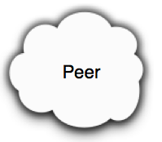
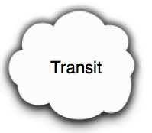
Local Control
overloaded
link
happy
links!
Peering
Router
?
Where should
this traffic go?
BGP
BMP,
NetFlow,
Counters
Local Controller
Notes:
essentially then what we decided to do was reuse the existing paradigm itself…
How do we take BGP and make it better...
First we needed data and counters....
Label BGP session
“metro controller”?
Began with router-level “hot link” offloads
But best alternate link may be on another router
Peer links may be asymmetric between peering routers
Lateral growth w/ decreasing peering & Transit symmetry
-> mention diversion can be to other peer/ix as well as transit

Slide 17
Why is my traceroute going over the Internet?
Global Controller, reacting to a change
DNS resolver
Talk to us, so we can investigate
Notes:
There are two common questions we are looking to answer through this presentation…
<CLICK> Global Controller, making a change
<AUTOLOAD> DNS resolver
<AUTOLOAD> Talk to us, so we can investigate

Slide 18
Why isn’t all my traffic being served over the peering/caching we just setup?
Different types of content
MNAs can only serve a subset of content
Popularity – Cache efficiency (hit/miss)
Performance measurements
Notes:
To answer the peering and caching question:
<CLICK> Different types of content
<AUTOLOAD> FNAs can only serve a subset of content
<AUTOLOAD> Popularity – Cache efficiency (hit/miss)
<AUTOLOAD> Performance Measurements

Slide 19

Let’s work together, we want to serve you the packets locally
3
We need you!
Notes:
This is the big call to action from the ISPs, and our chance to sell taking or expanding peering and caching with us

Slide 20
4 METHODS OF EGRESS
Notes:
We have 4 main methods of egress

Slide 21

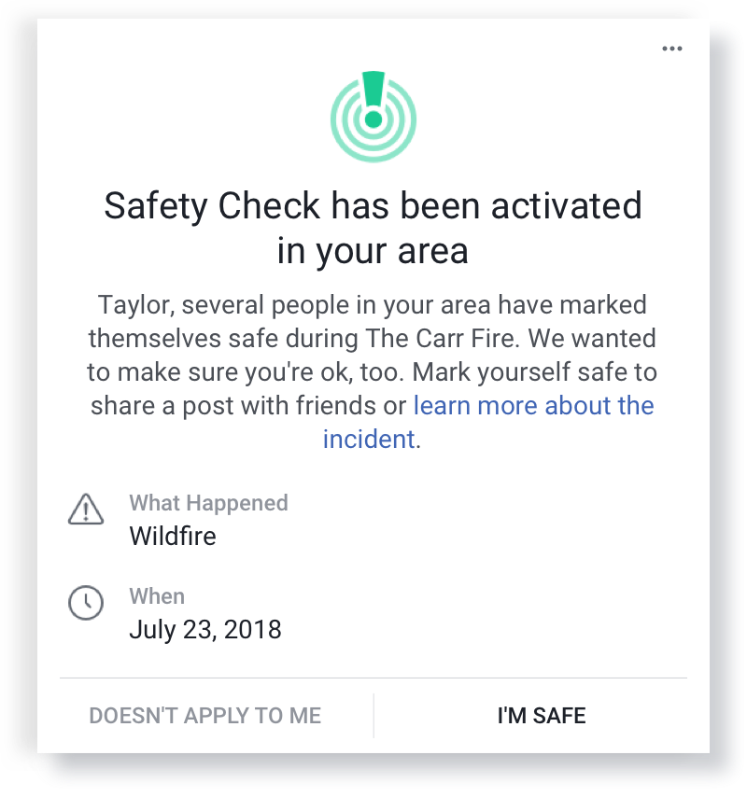
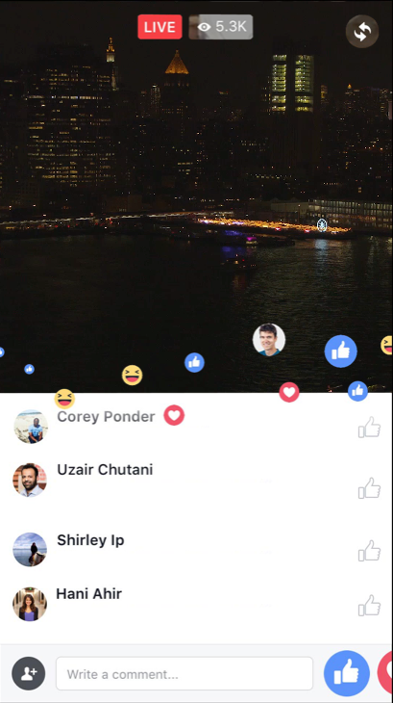
CACHING
1
For qualifying networks^{[1]}
Offload pictures and videos in network
Absorb huge peaks
Build resilient topologies
FOR MORE INFORMATION: META.COM/PEERING
^{[1]} Qualification is different per region, and depends on a range of factors
Notes:
Bullets load automatically
Caching
Like other OTT and CDN providers, we have an on-net offering – FNA Facebook Network Appliance
Available for qualifying networks
This can provide offload for pictures and videos across our product set – this is the bulk of the traffic
Really helps to absorb huge peaks
We can build resilient topologies inside your network
<click>
Safety Check appears
iPhone appears with live video
These are just two examples of things which can drive huge spikes in traffic. Live video and safety check

Slide 22
LOCAL PEERING
2
Many IX Peering options globally
PNI ^{Nx}10G-LR or ^{Nx}100G-LR1/4 for qualifying^{[1]} networks
You must maintain a PeeringDB record
FOR MORE INFORMATION: META.COM/PEERING
^{[1]} Qualification is different per region, and depends on a range of factors
Notes:
Bullets load automatically
Local Peering
We’re available on 70+ IXPs globally – and generally have multiple available in a metro
For qualifying networks, PNIs of Nx10G and Nx100G are available. *** Try to avoid talking about requirements ***
You MUST MAINTAIN a peeringDB record. We have heavy automation and peering isn’t possible without it

Slide 23
REGIONAL PEERING
3
Multiple Metro peering desired
Consistent prefix announcements expected
Latency drives delivery location
Speak to us about traffic engineering
FOR MORE INFORMATION: META.COM/PEERING
^{[1]} Qualification is different per region, and depends on a range of factors
Notes:
Bullets load automatically
If we overlap in multiple locations, peering in all is preferred
We expect consistent prefix announcements (may want to talk about how we don’t deliver consistent prefixes?)
Latency drives our delivery decision
– talk about how path prepends won’t help etc

Slide 24
TRANSIT
4
Last resort, unless we don’t peer
Used when PNIs become full, or links fail
We aim to deliver to the closest point of interconnect with your transit
Notes:
Bullets load automatically
Used by EF when PNIs become full
Last resort unless we don’t peer – but why wouldn’t you peer?
We aim to deliver as close to your point of interconnect with your transit as possible

Slide 25

Questions?

